Slide 1

Optimizing Cold Starts in FaaS with Machine Learning
Saury Pande
Chair of Computer Architecture and Parallel Systems,
Technical University of Munich (TUM)
Munich: 25.05.2023
Notes:
1

Slide 2
Outline
Function as a Service (FaaS)
Problem of Cold Start
Existing Approaches
Our Contribution
Methodology
Experimental Setup
Results
Conclusion and Future Work

Slide 3

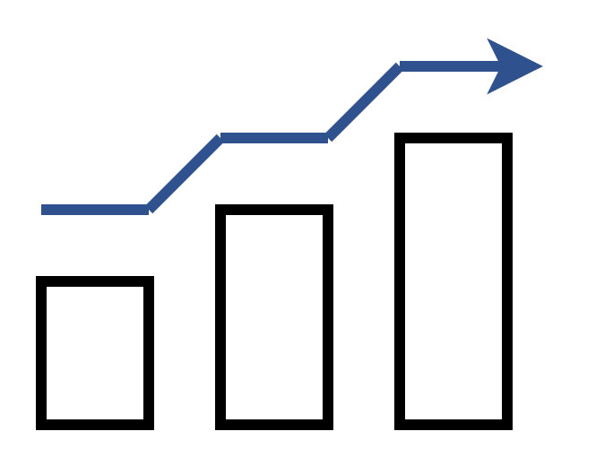


What is Serverless?
Pay for use
Scalability with usage
No Infrastructure Management
Built in High Availability and
Fault Tolerance
Notes:
Serverless is a cloud computing model or an abstraction that is provided by the various cloud providers that let you pay for what you use and you don‘ t need pay when there are no requests being served. It gives an illusion of infinite elasticity from 0 to infinity and back. Developers does not need to worry about any infrastructure management like provisioning, configuring and managing servers. It provides built in support for high availiability and fault tolerance so that the application are always available and performant.

Slide 4
Function as a Service (FaaS)
An attractive offering of Serverless
Functions have no persistent state among invocations
Benefits of FaaS
Greater Agility
Develop self contained function
Upload those functions in cloud
Get an endpoint and it is ready to use
Scalability
Faster time to market
Notes:
FAAS is an attractive offering from serverless.
Here functions are built having no persistent state among invocations.
It increases the agility of development as user just need to develop self contained functions
It is highly scalable both outwards and inwards
As developers does not need to worry about the infrastructure management so it is faster to bring their application live in the market

Slide 5
Problem of Cold Start
Increase in Response Time Latency
Increase in Cost
Inefficient Resource Utilization
Notes:
Now moving towards the limitations of FaaS there is a common challenge in every service provider that is a problem of cold start.
When we deploy our service in the serverless environment with scalability to zero. When ever the first request comes. A new container is spin up from scratch. This process takes time and is called as cold start.
The cold start duration is billed on the customer as it adds to function running time.
There are ways developers try to reduce cold starts but they result is inefficient resource utilization
This whole process typically range from 0.2 to few seconds resulting in delayed response

Slide 6
Existing Solutions
Solutions that are proposed to reduce cold start are broadly classified into two categories :
Reducing cold start duration
Container Reusing Techniques - Snapshot technique (FaaSnap)
Code Optimization Techniques
Preventing occurance of cold start
Fixed Keep Alive Policy
Provisioning minimum containers to be always active
Pre-warming Techniques
Notes:
To overcome this cold start problem there are various solutions which can be broadly classified
container reusing techniques – creating resources like network elements beforehand and then attaching them to the containers dynamically.
FaaSnap make use of VM snapshots and then reuse them once a request arrives.
Code Optimization techniques that help in reducing the code deployment package size that results in reducing cold start duration.
In Fixed keep alive policy the containers remain warm for like 10 to 20 min depending on the service provider after serving the requests. It’s implementation and integration is simple.
In pre warming techniques there are methods that try to periodically invoke functions at regular intervals. There are methods that use reinforcement-based techniques, histogram-based techniques or forecasting models like ARIMA.

Slide 7
Problems with Existing Approaches
Approaches that try to reduce cold start duration are not able to eliminate the occurrence of cold starts.
Most approaches are not SLO (Service Level Objectives) aware.
In most solution‘s evaluation against real production traces missing.
Existing pre-warming techniques does not consider both concurrency and number of active instances.
Fixed keep alive policy results in higher costs
Missing forecasting model retraining after performance degradation.
Notes:
Solutions which try to reduce the overall cold start time are language dependent.
There is a limit to which the time can be reduced
talk more about related approach shortcomings
therefore there are significant delay in response

Slide 8
Our Contribution
Trained and tested ML and Deep Learning Models to determine effective invocation forecasting mechanism.
Developed a tool SmartOpt to pre-create container instances.
Developed a Load generator tool to simulate the functions invocation behavior.
Evaluate our strategy with existing available solutions like default Knative Pod Autoscaler (KPA) and KPA with concurrency one.
Analysed response time, SLO violations, requests served, and costs

Slide 9
Timeseries Models
ML Models
FFT (Fast Fourier Transform)
Prophet
Deep Learning Model
N-BEATS
N-HITS

Slide 10
ML Model Predictions

Slide 11
Deep Learning Model Predictions

Slide 12
Training time of Timeseries Models

Slide 13
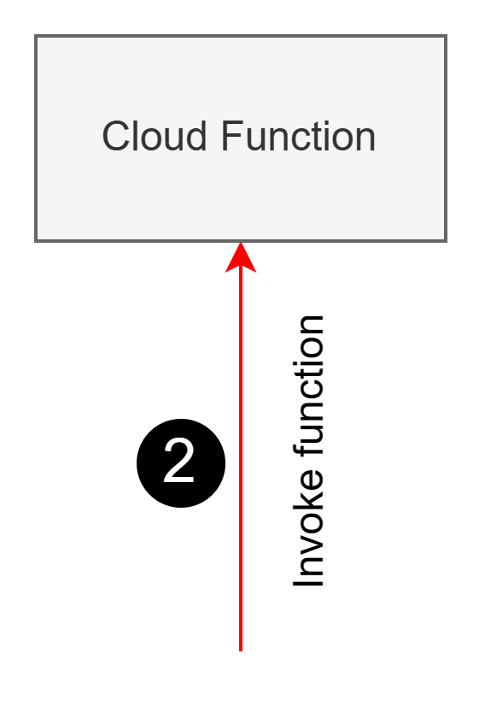
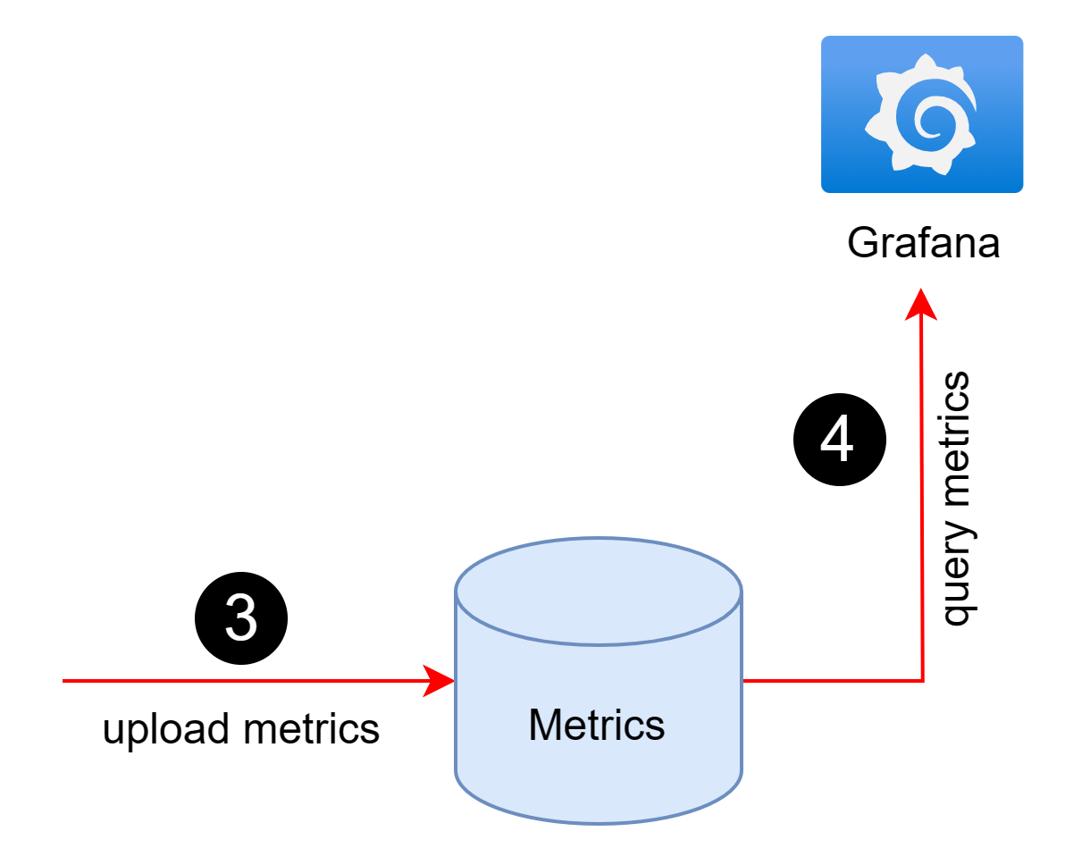
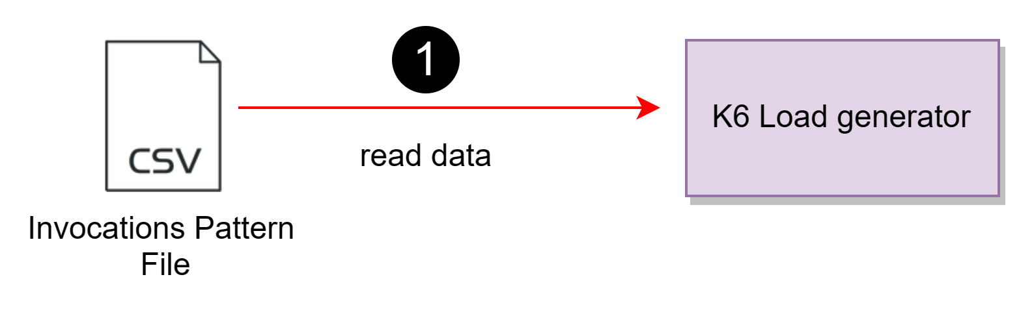
Load Generator Architecture
Notes:
Invocation file contains the function and its invocation patters that is no of requests that are send in each minute

Slide 14
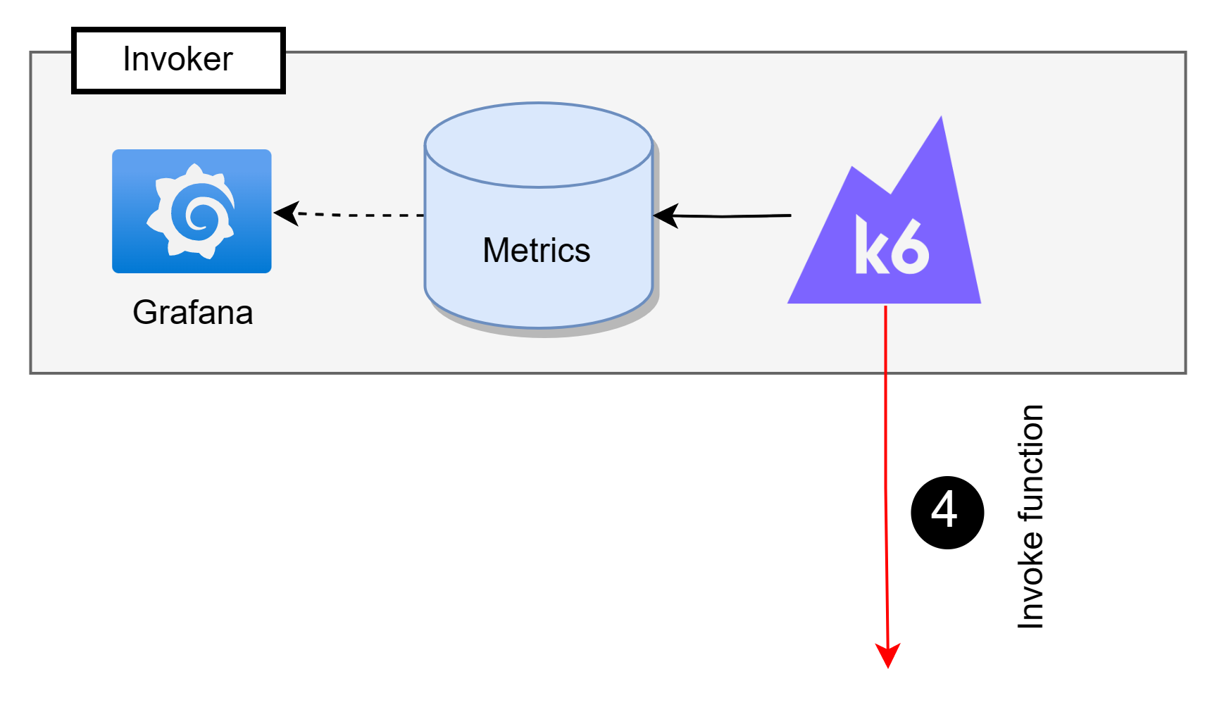
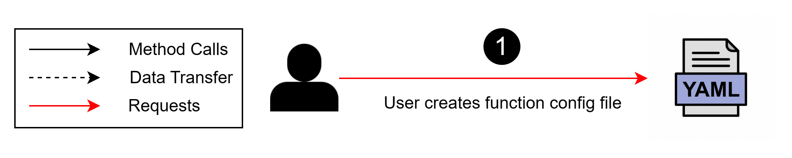


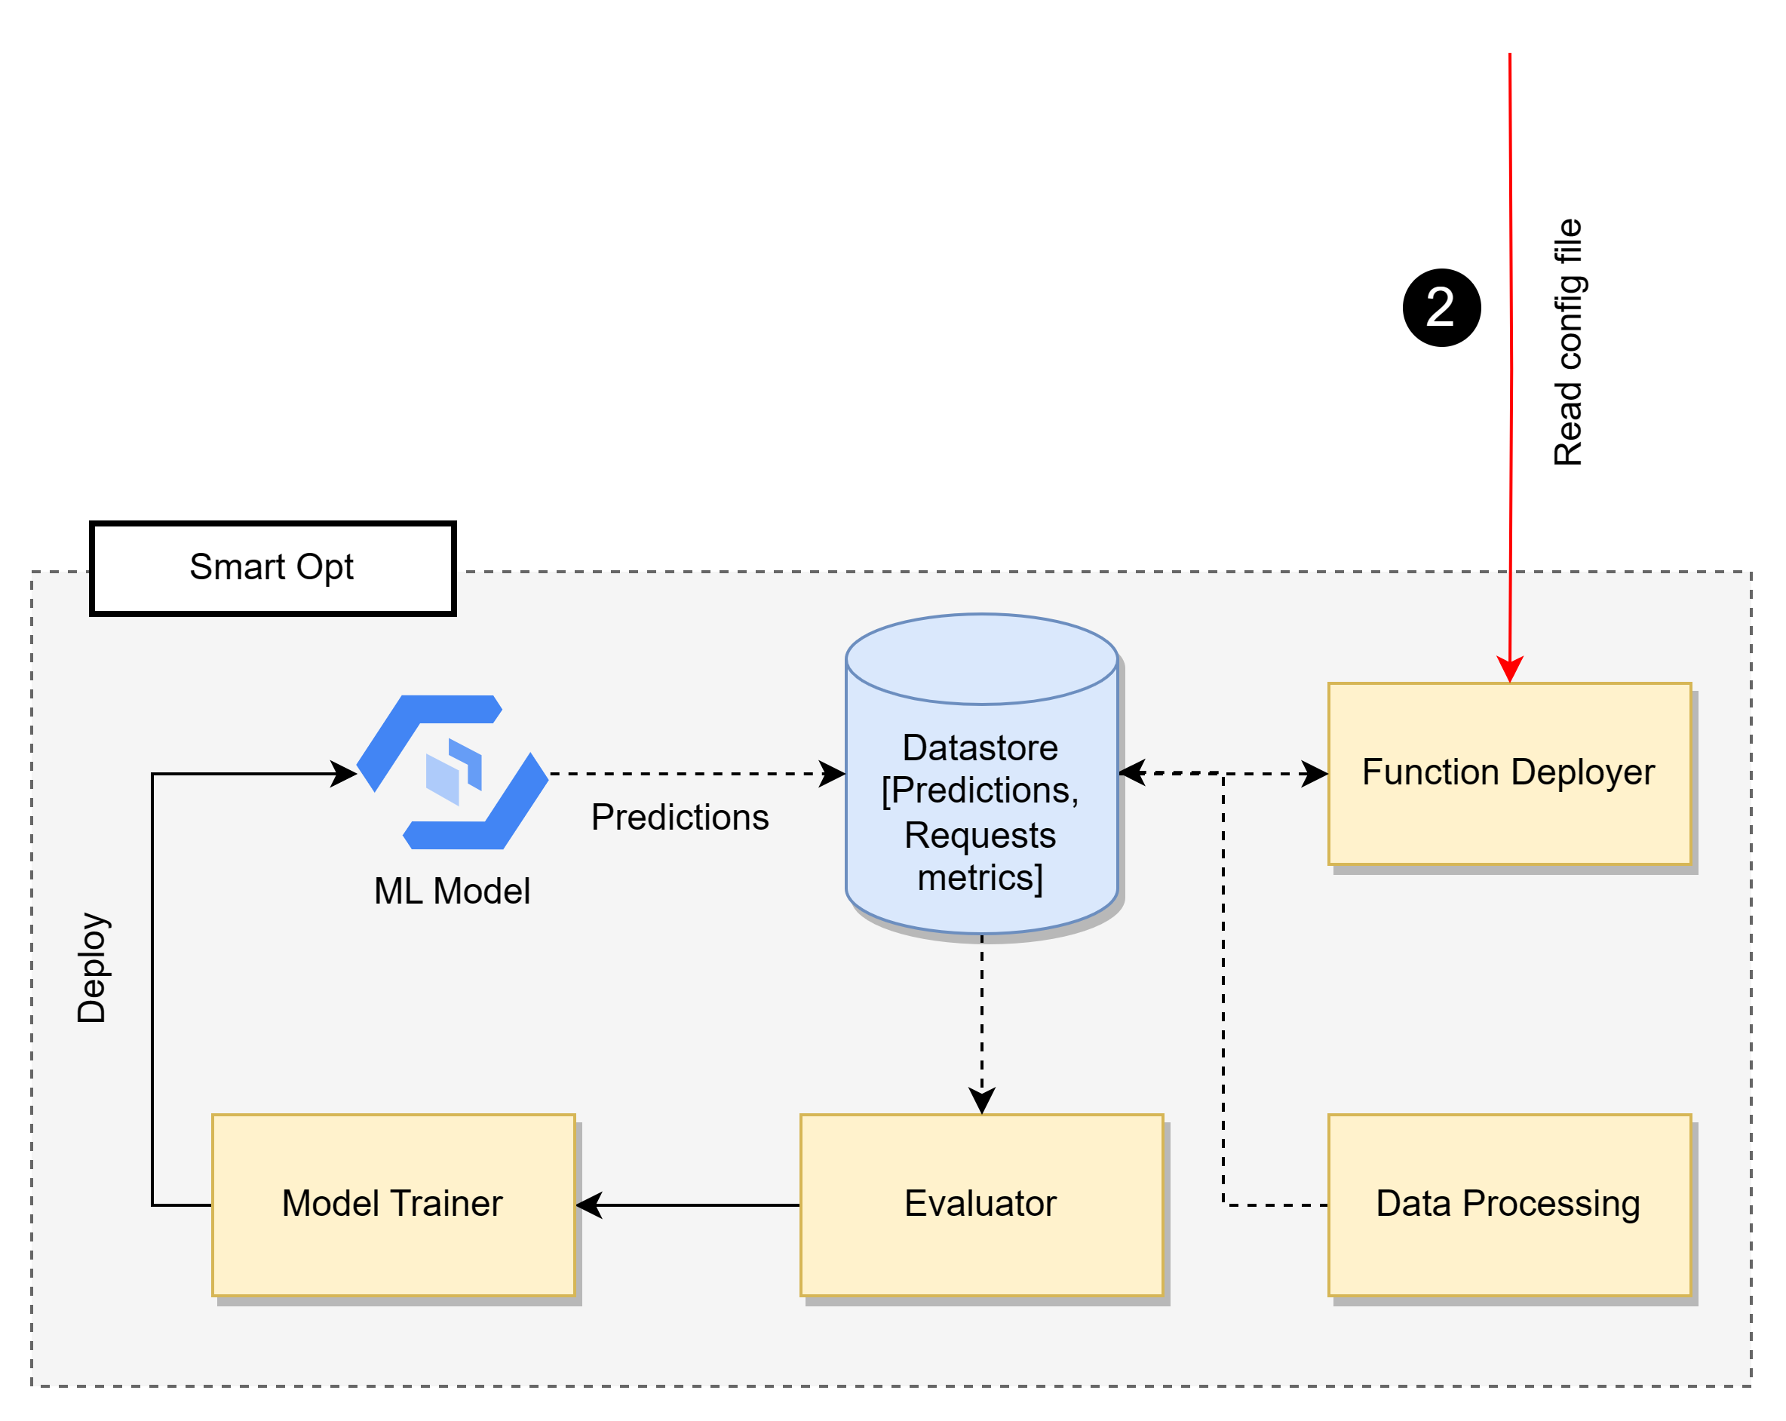
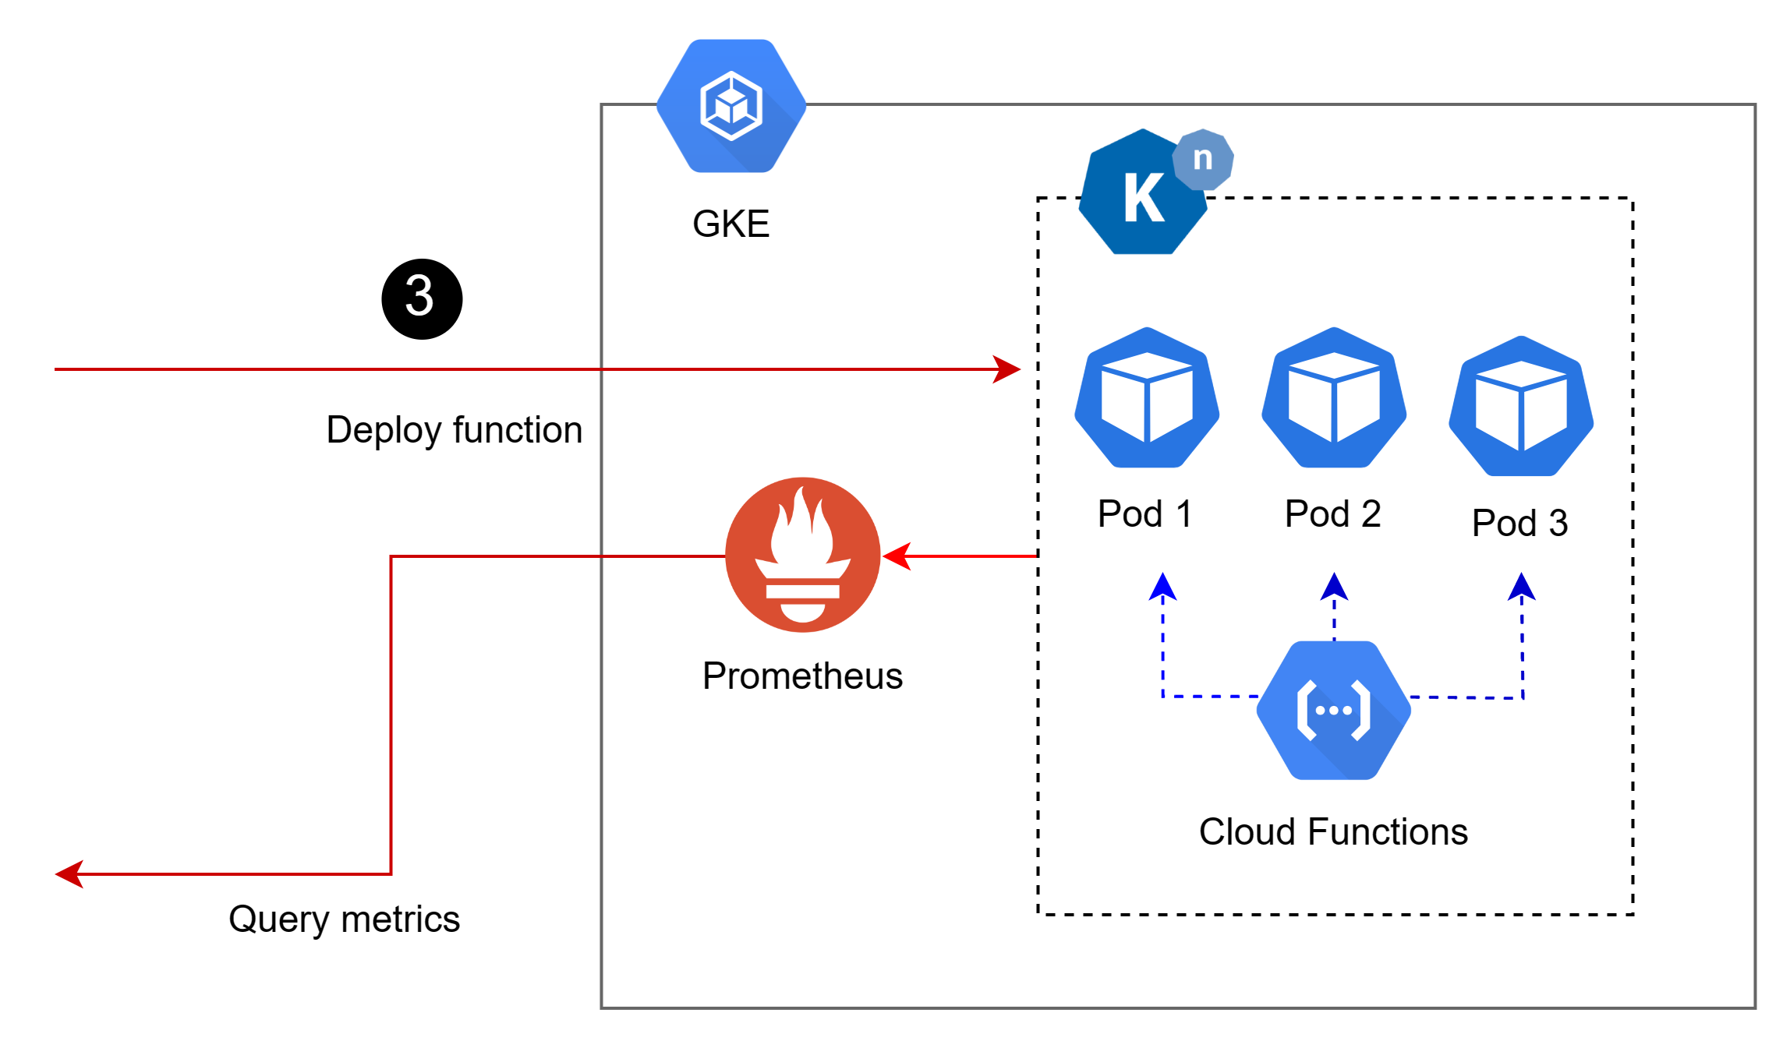





SmartOpt Architecture and Workflow

Slide 15
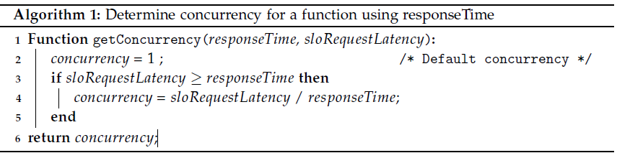
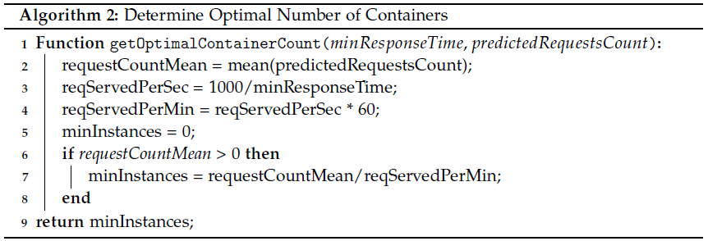
Determine concurrency and Containers

Slide 16
Functions Selections
Open-source Azure functions traces ^{[1]}
12 Functions are selected and divided into 4 groups :
Category 1: (High No of Invocations, High Execution Time)
Category 2: (High No of Invocations, Low Execution Time)
Category 3: (Low No of Invocations, High Execution Time)
Category 4: (Low No of Invocations, Low Execution Time)
^{[1]} AzurePublicDataset/AzureFunctionsDataset2019.md at master · Azure/AzurePublicDataset · GitHub

Slide 17
Strategies Evaluated
Strategy | Description
Strategy 1 | Default Knative Pod Autoscaler (KPA) settings.
Strategy 2 | Knative Pod Autoscaler with concurrency level as 1.
Strategy 3 | SmartOpt with model set as Fast Fourier Transform. In (Concurrency determining) Algorithm, minimum response time is used.
Strategy 4 | SmartOpt with model set as N-BEATS. In (Concurrency determining) Algorithm, minimum response time is used.
Strategy 5 | SmartOpt with model set as N-BEATS. In (Concurrency determining) Algorithm, average response time is used.

Slide 18
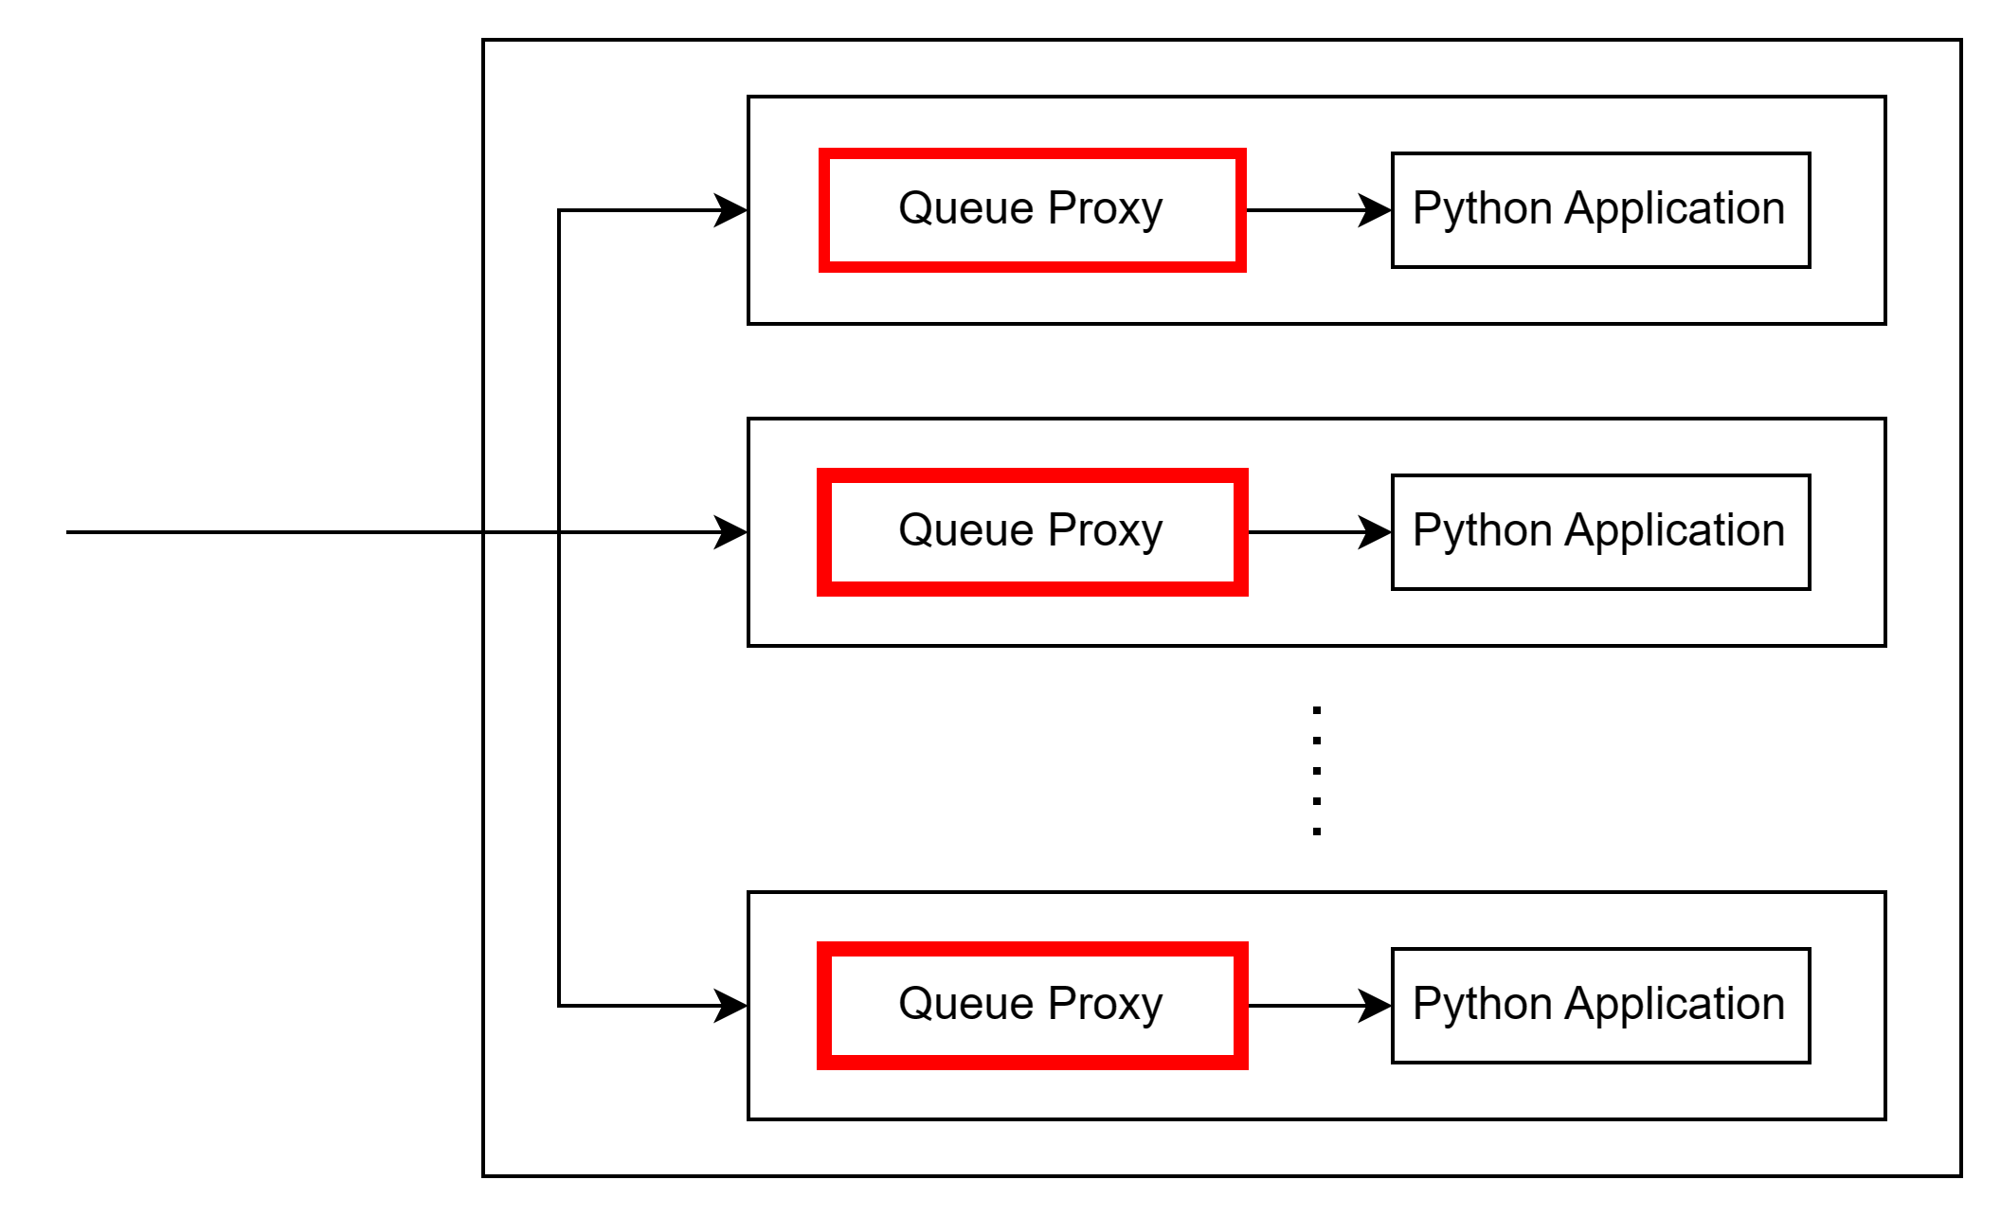
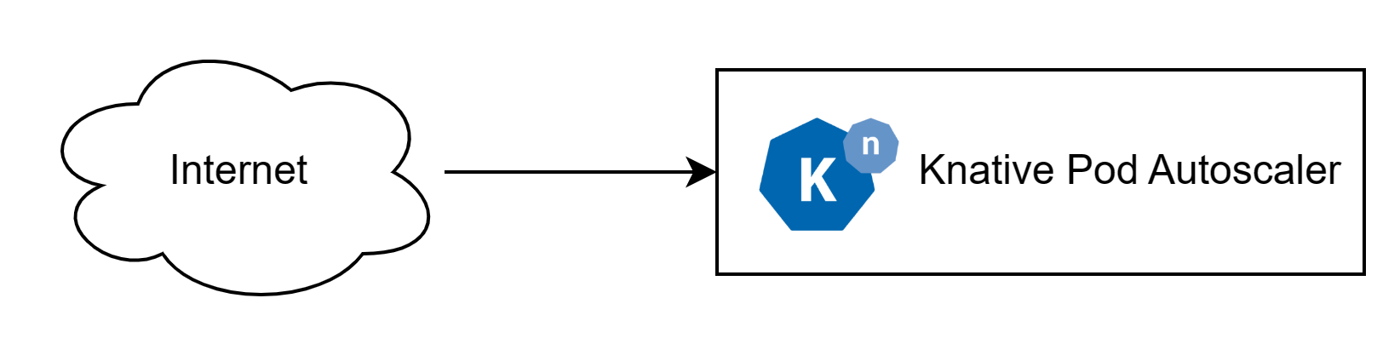


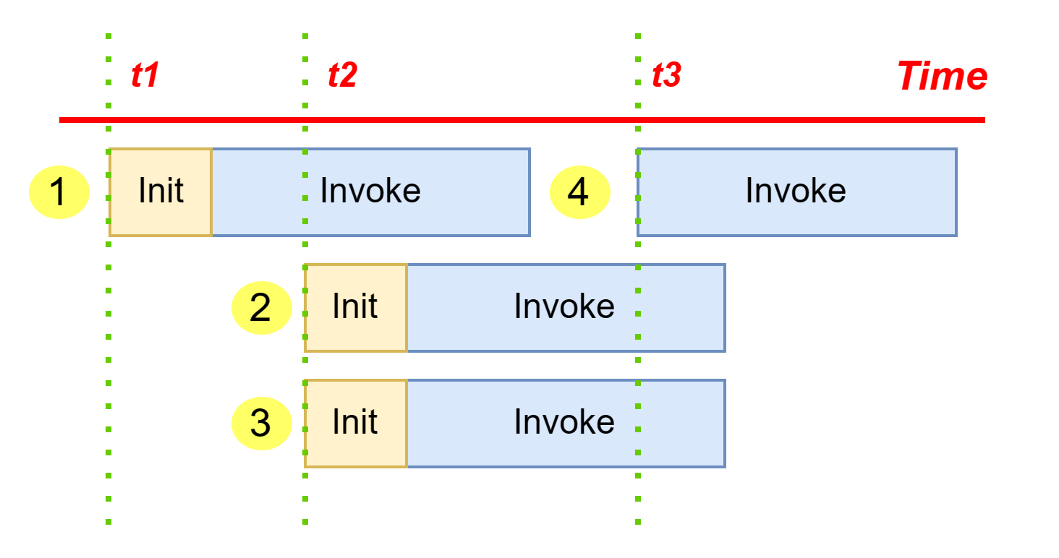
Requests Flow in Knative
Notes:
The Queue-Proxy is a sidecar container. When you submit a Service or Configuration,
Knative adds the Queue-Proxy to the Pod. Queue proxy set as 1 means only 1 request is allowed to be flown at the revision
Request would be waiting in that queue.
How many request would be waiting in the queue before being served by that particular pod

Slide 19
Evaluation Criteria
Response time of requests
Total requests fulfilled and the number of requests dropped.
Total containers active during the 15 minutes time interval for each test.
Total estimated costs required for each test.
Total number of SLO (Service Level Objectives) breached.

Slide 20
Response Time – Category 1

Slide 21
Response Time – Category 2

Slide 22
Response Time – Category 3

Slide 23
Response Time – Category 4

Slide 24
Response Time Metrics

Slide 25
Response Time Metrics

Slide 26
Total Requests Served

Slide 27
Experiment Costs Estimates

Slide 28
SLO Violation

Slide 29
Containers
Notes:
strategy 1 = 91 % less containers
strategy 2
strategy 3 = 60%
strategy 4 = 62%
strategy 5 = 22%

Slide 30
Conclusion
Default Knative solution only performed well on those categories of functions that are invoked infrequently and have low execution time.
Strategy-4 where N-Beats model is used performed better against Strategy-3 where FFT model is used in terms of SLO violation, costs and more requests served.
Strategy-5 where N-Beats model is used and average response time is used in determining concurrency, outperformed all other strategies.
Notes:
In strategy 2 where concurrency is set as 1, we can observe that there is drastically
improvement in performance. We can see that the amount of dropped requests is less
than 0.1% and SLO violation rate is 3.78%.

Slide 31
Future work
Integrate the utilization level of containers as an additional parameter in our tool to further improve the creation of a configuration policy for the functions.
Resources for the pods like vCPU and Memory were fixed during our experimentation. Need to evaluate the impact of these resource changes on the function's performance.
Due to budget constraints scaling of functions was set max at 80 which can be increased for functions which have very high invocations.
Notes:
container resources like memory and
CPUs on the performance of the functions. In our work, we have fixed these resources for all
containers to evaluate our tool

Slide 32
Thank You!

Slide 33
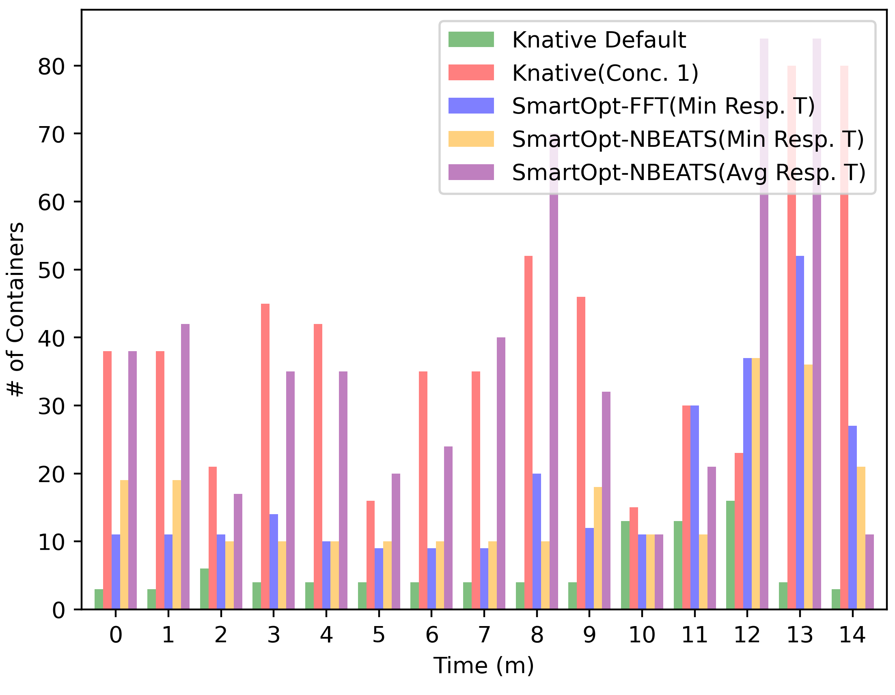
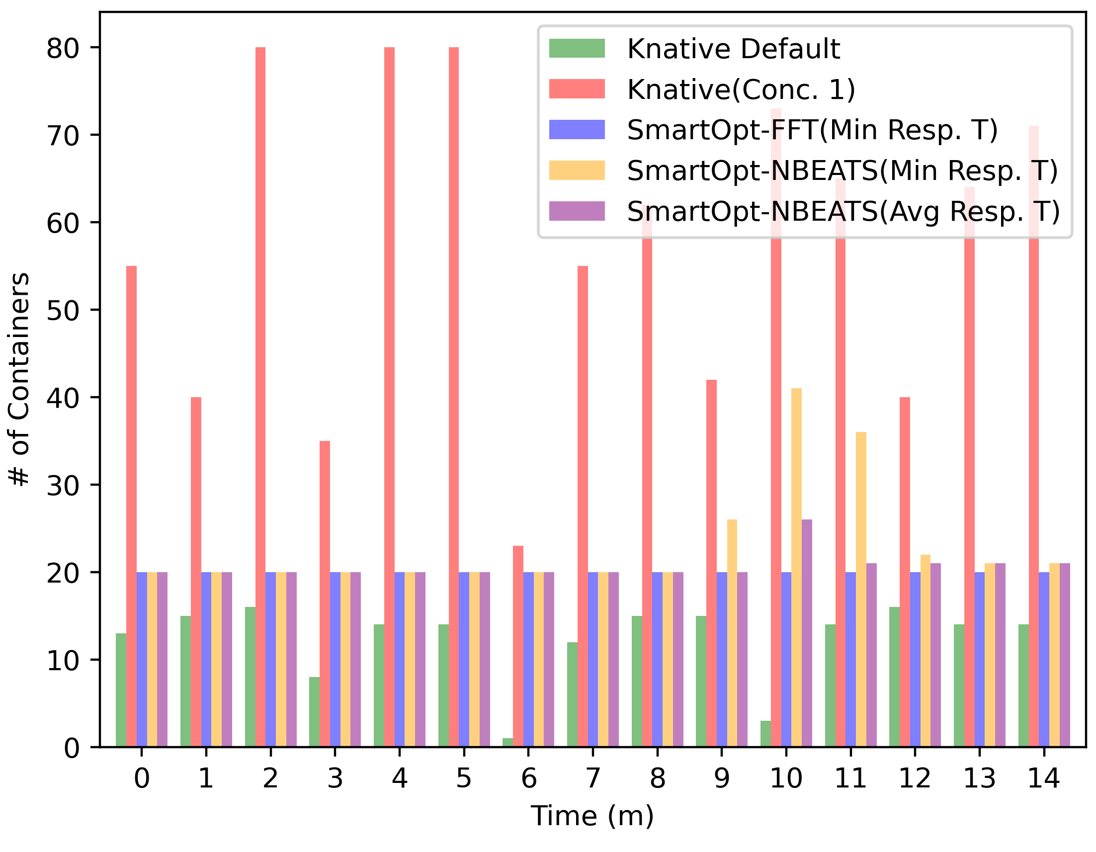
Container
Fig 1: Category 1 (J)
Fig 2: Category 2 (G)

Slide 34
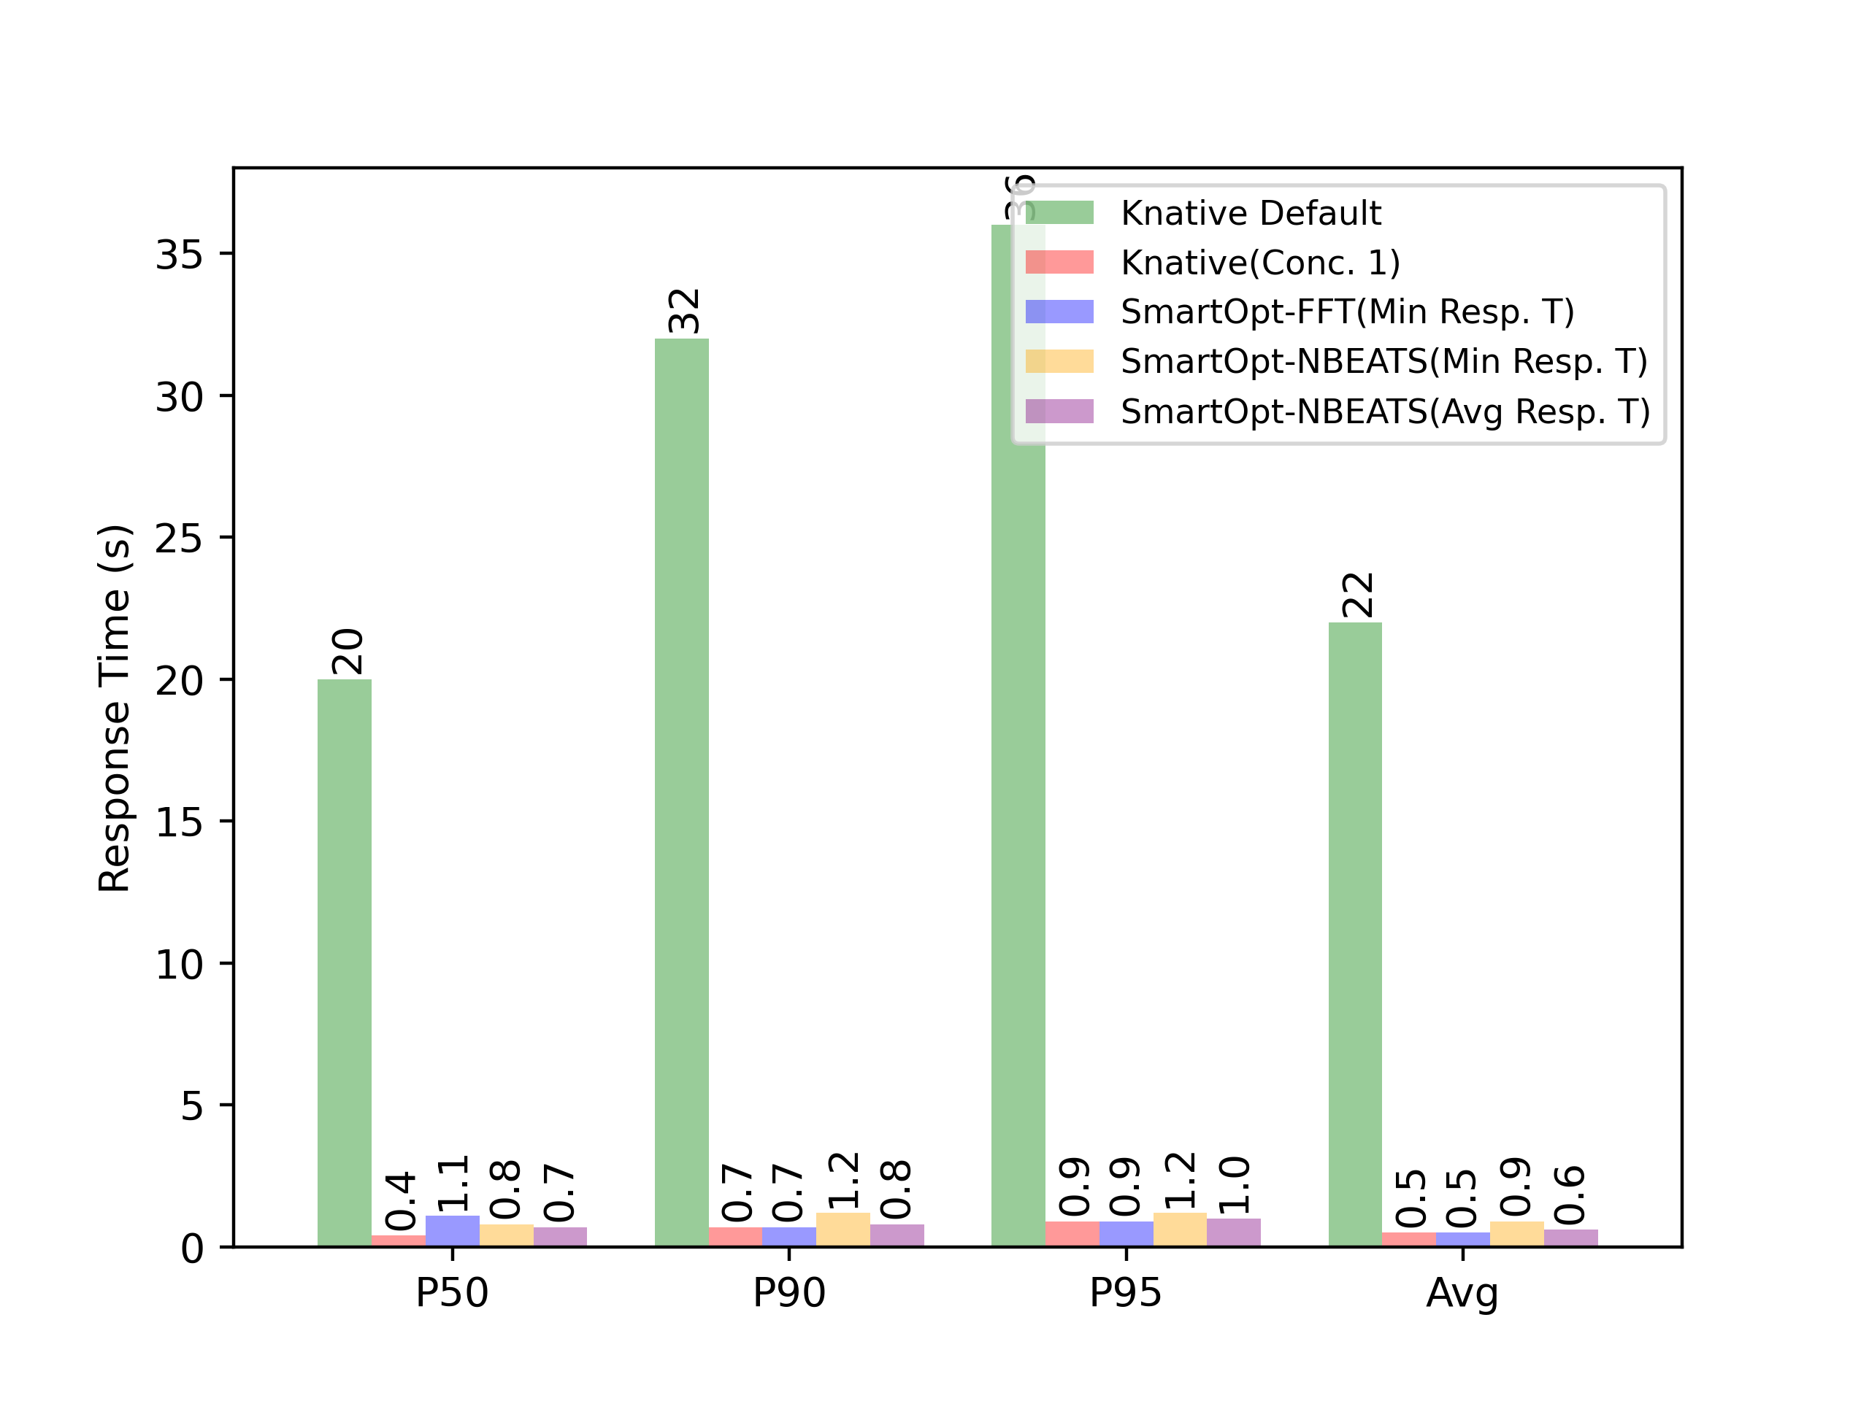
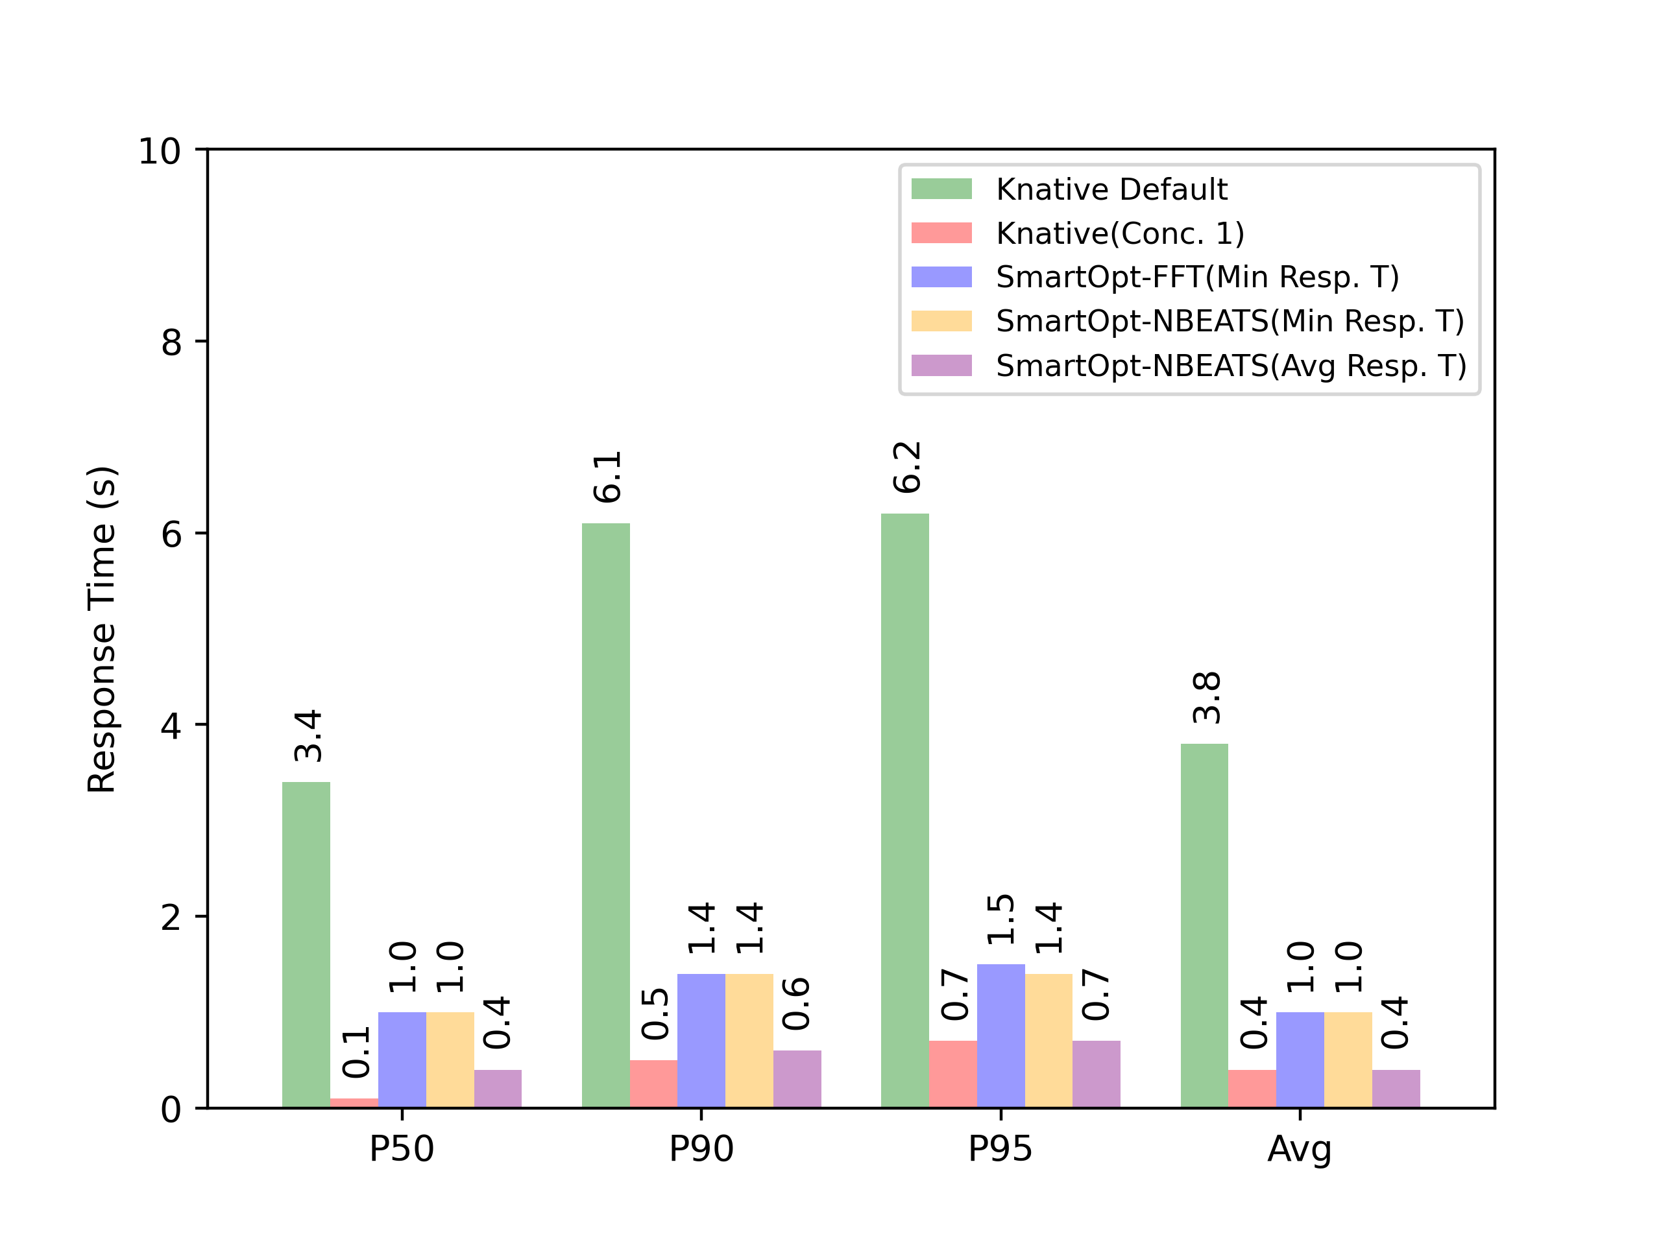
Response Time Metrics
Fig 1: Category 1 (J)
Fig 2: Category 2 (H)

Slide 35
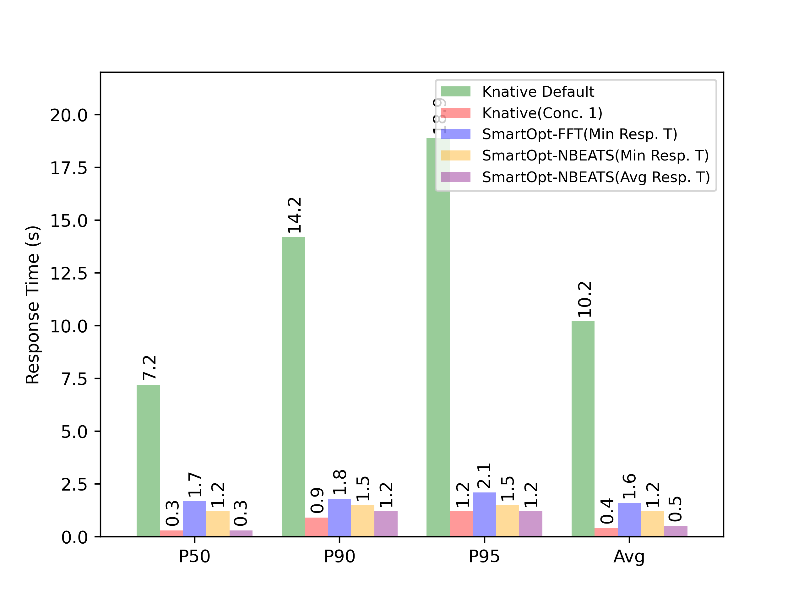
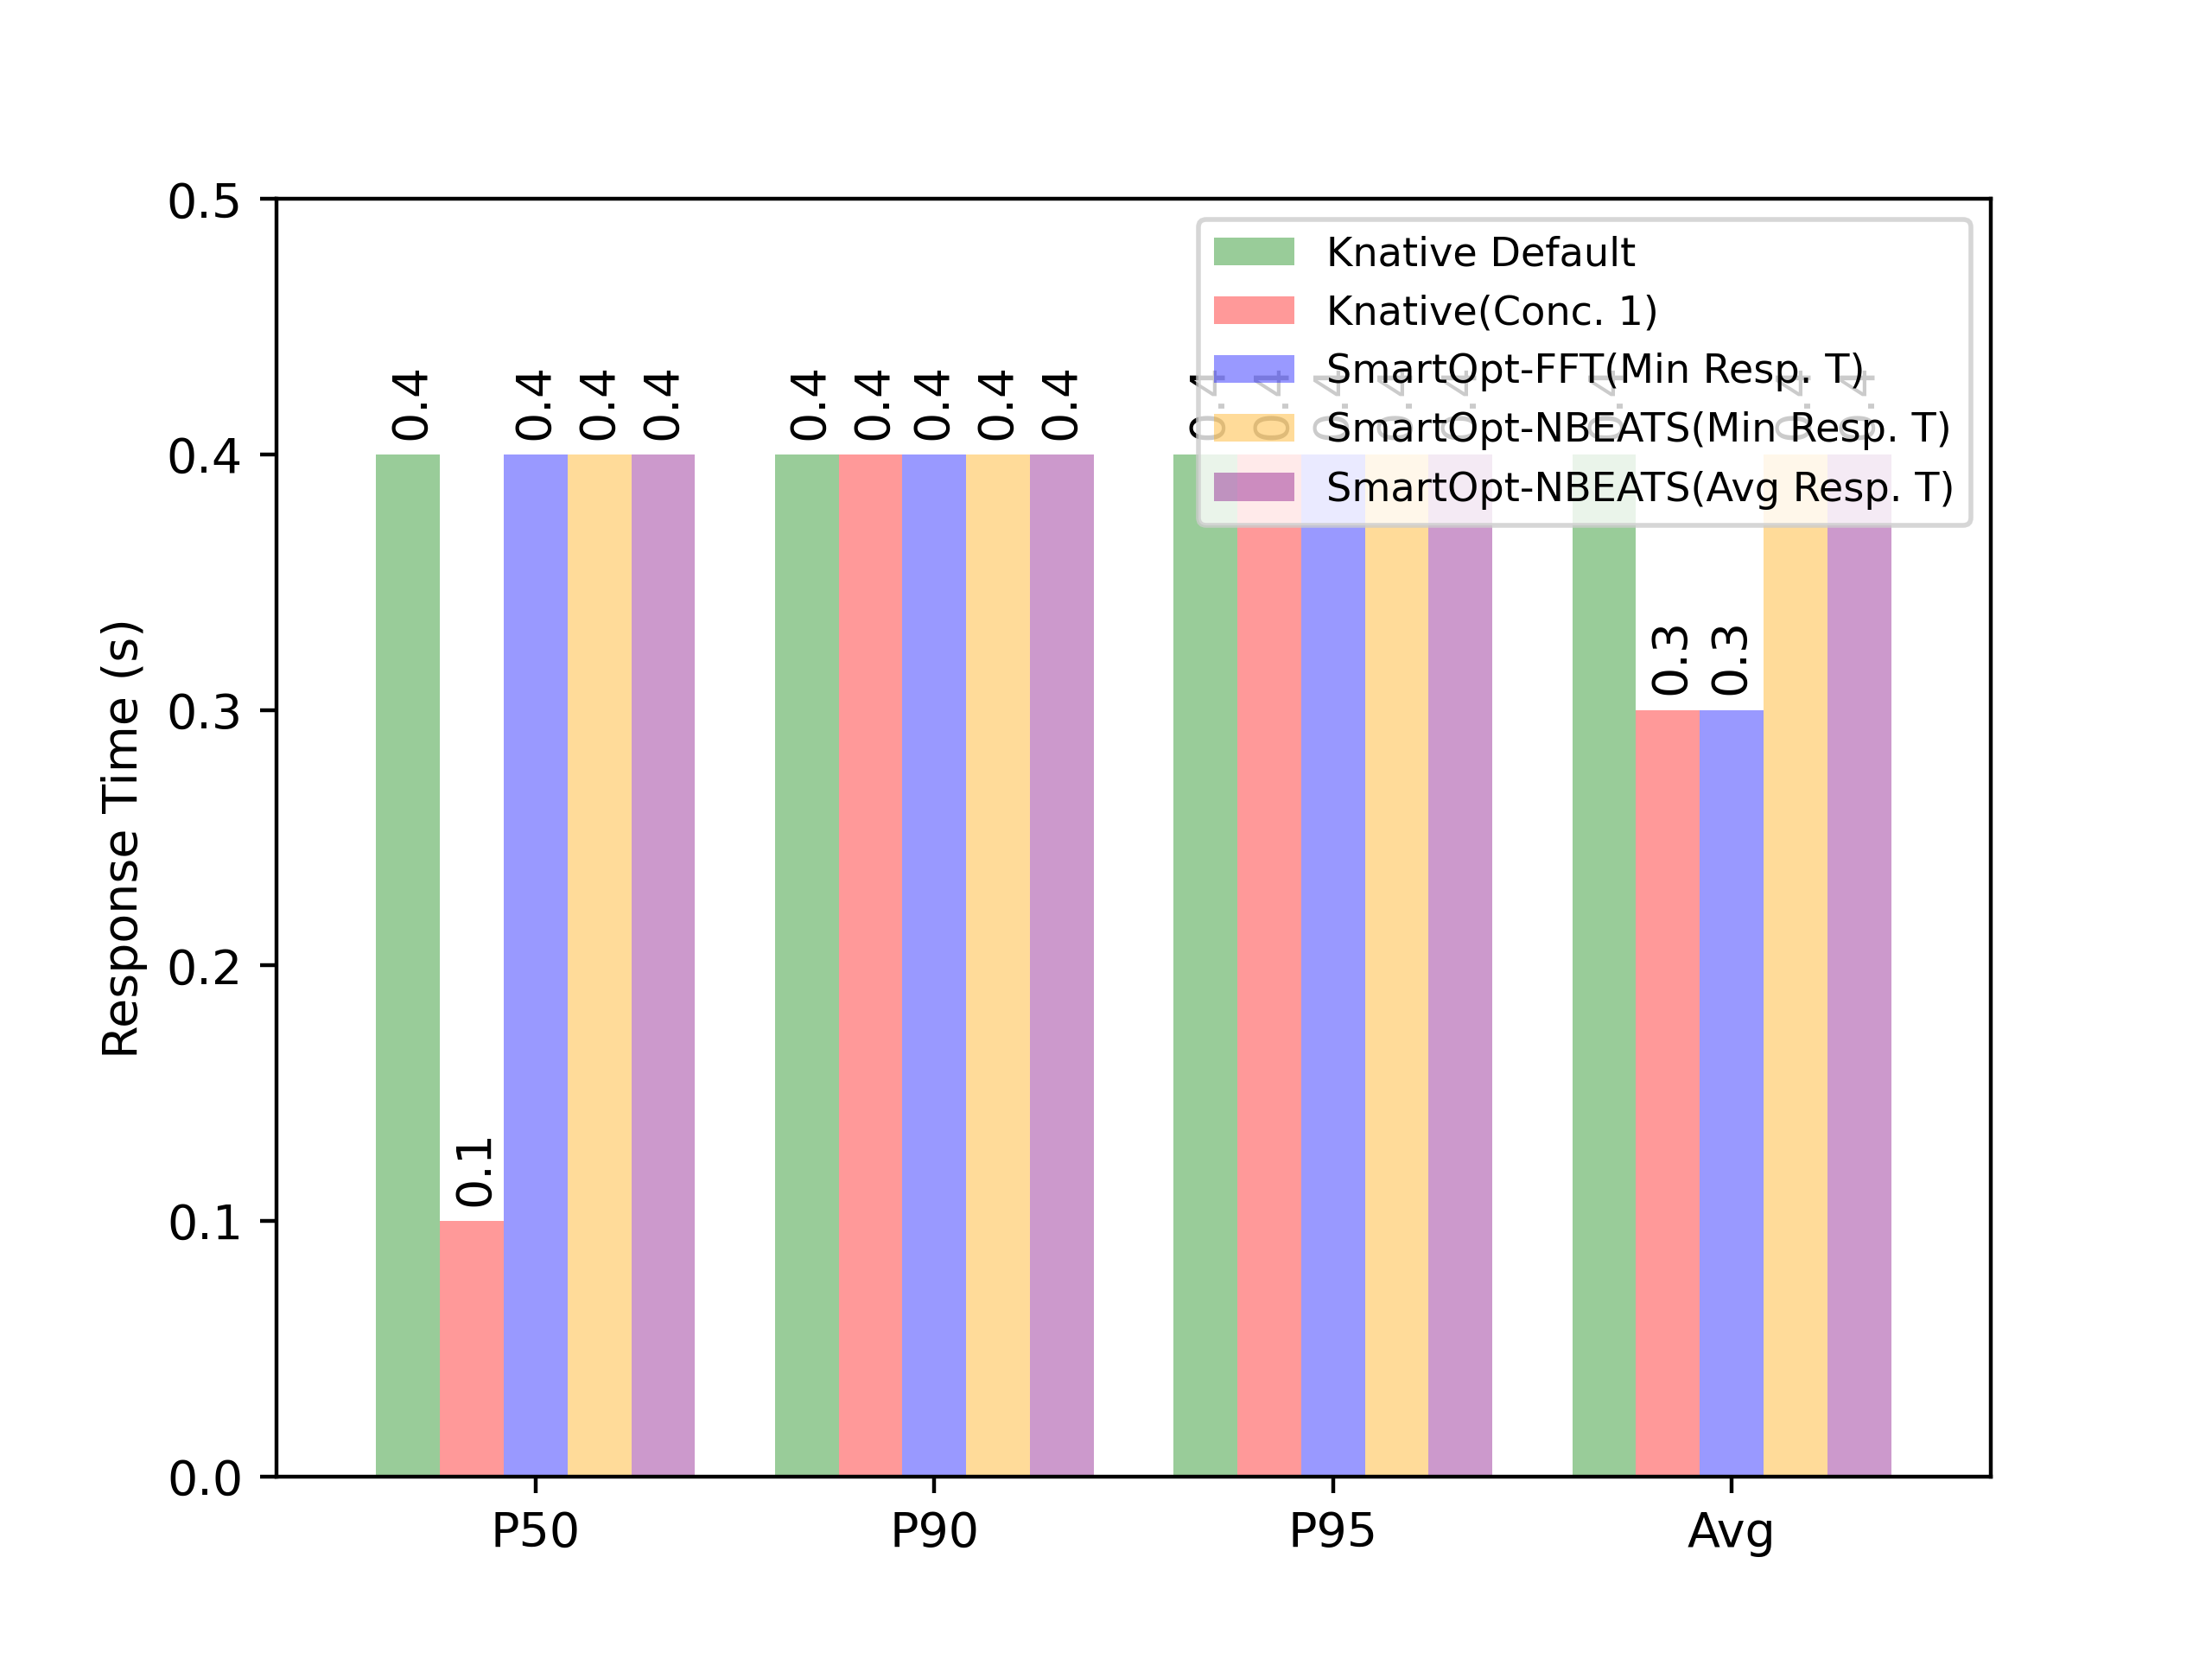
Response Time
Fig 1: Category 3 (E)
Fig 2: Category 4 (B)

Slide 36
Experiment Workflow
Describe about experiment workflow
Functions
Categories
Time period
Python functions and reason behind why those things were done
Why the strategies were chosen?

Slide 37
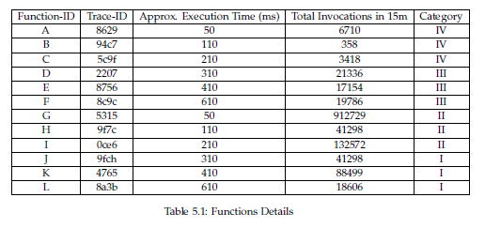
Notes:
9f7c – Category 2
9f7chh-category 1

Slide 38
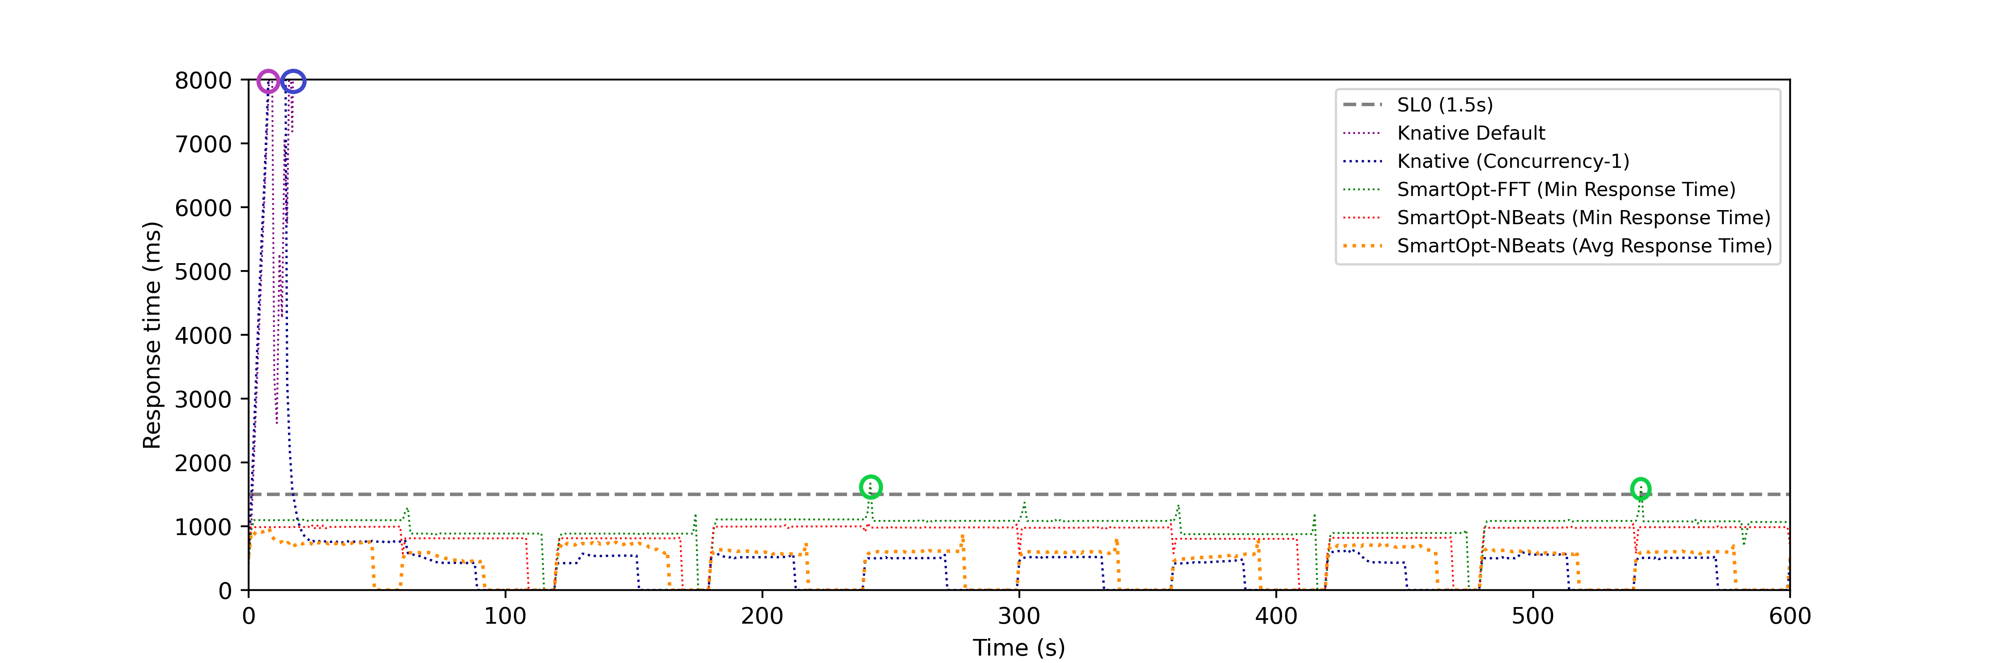
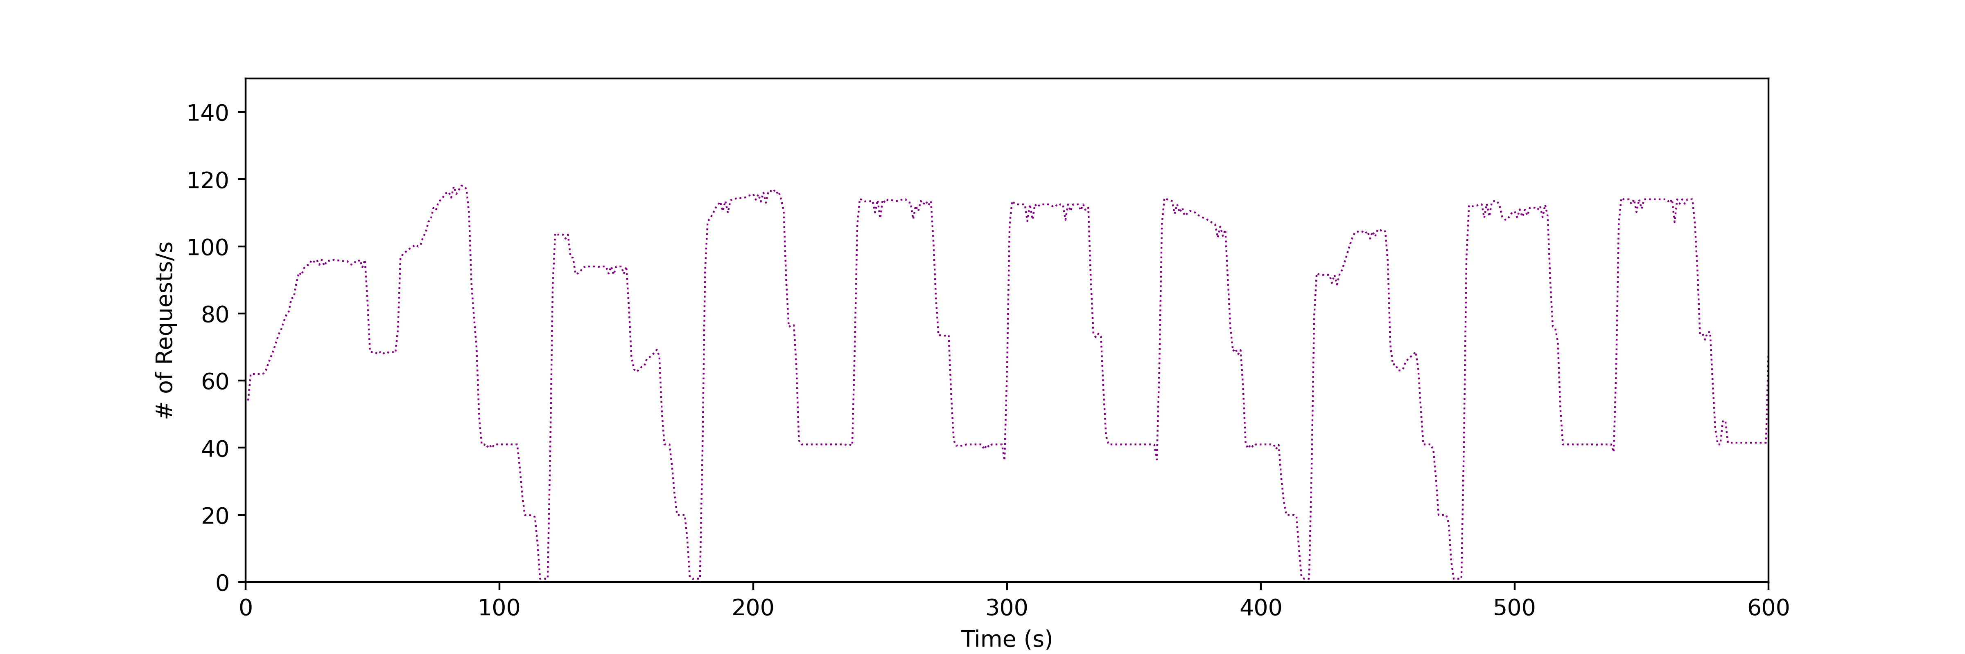
Response Time – Category 1
Fig 1: Response Time (J)
Fig 2: User Requests Pattern

Slide 39
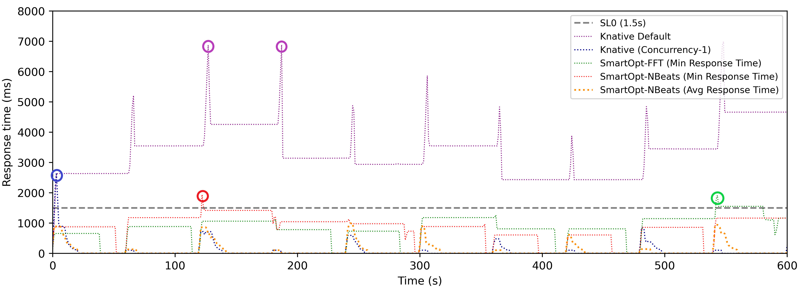
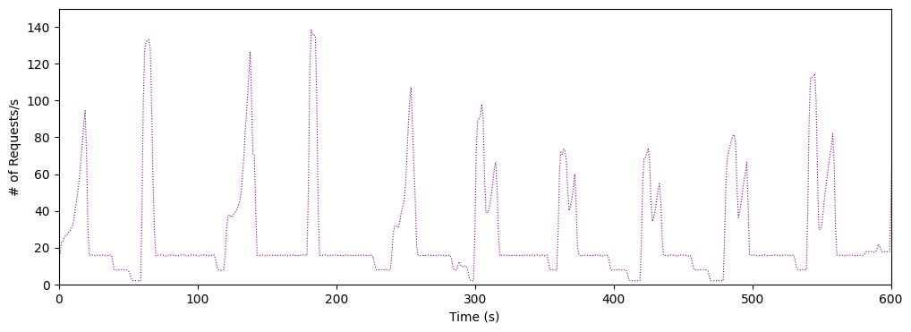
Response Time – Category 2
Fig 1: Response Time (H)
Fig 2: User Requests Pattern

Slide 40
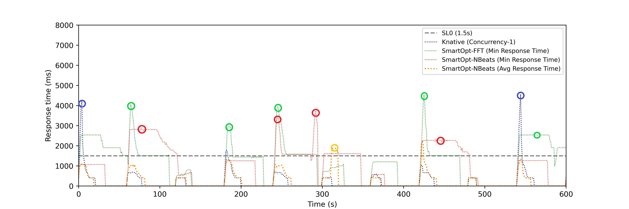
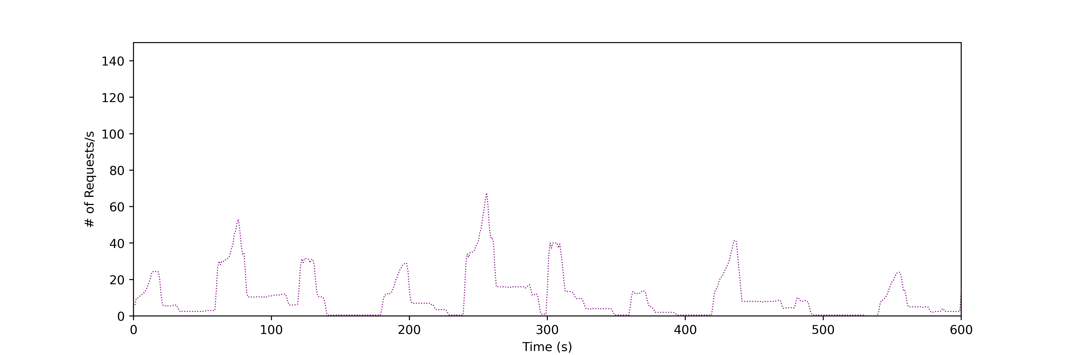
Response Time – Category 3
Fig 1: Response Time (E)
Fig 2: User Requests Pattern
Notes:
Removed Knative default from the graph

Slide 41
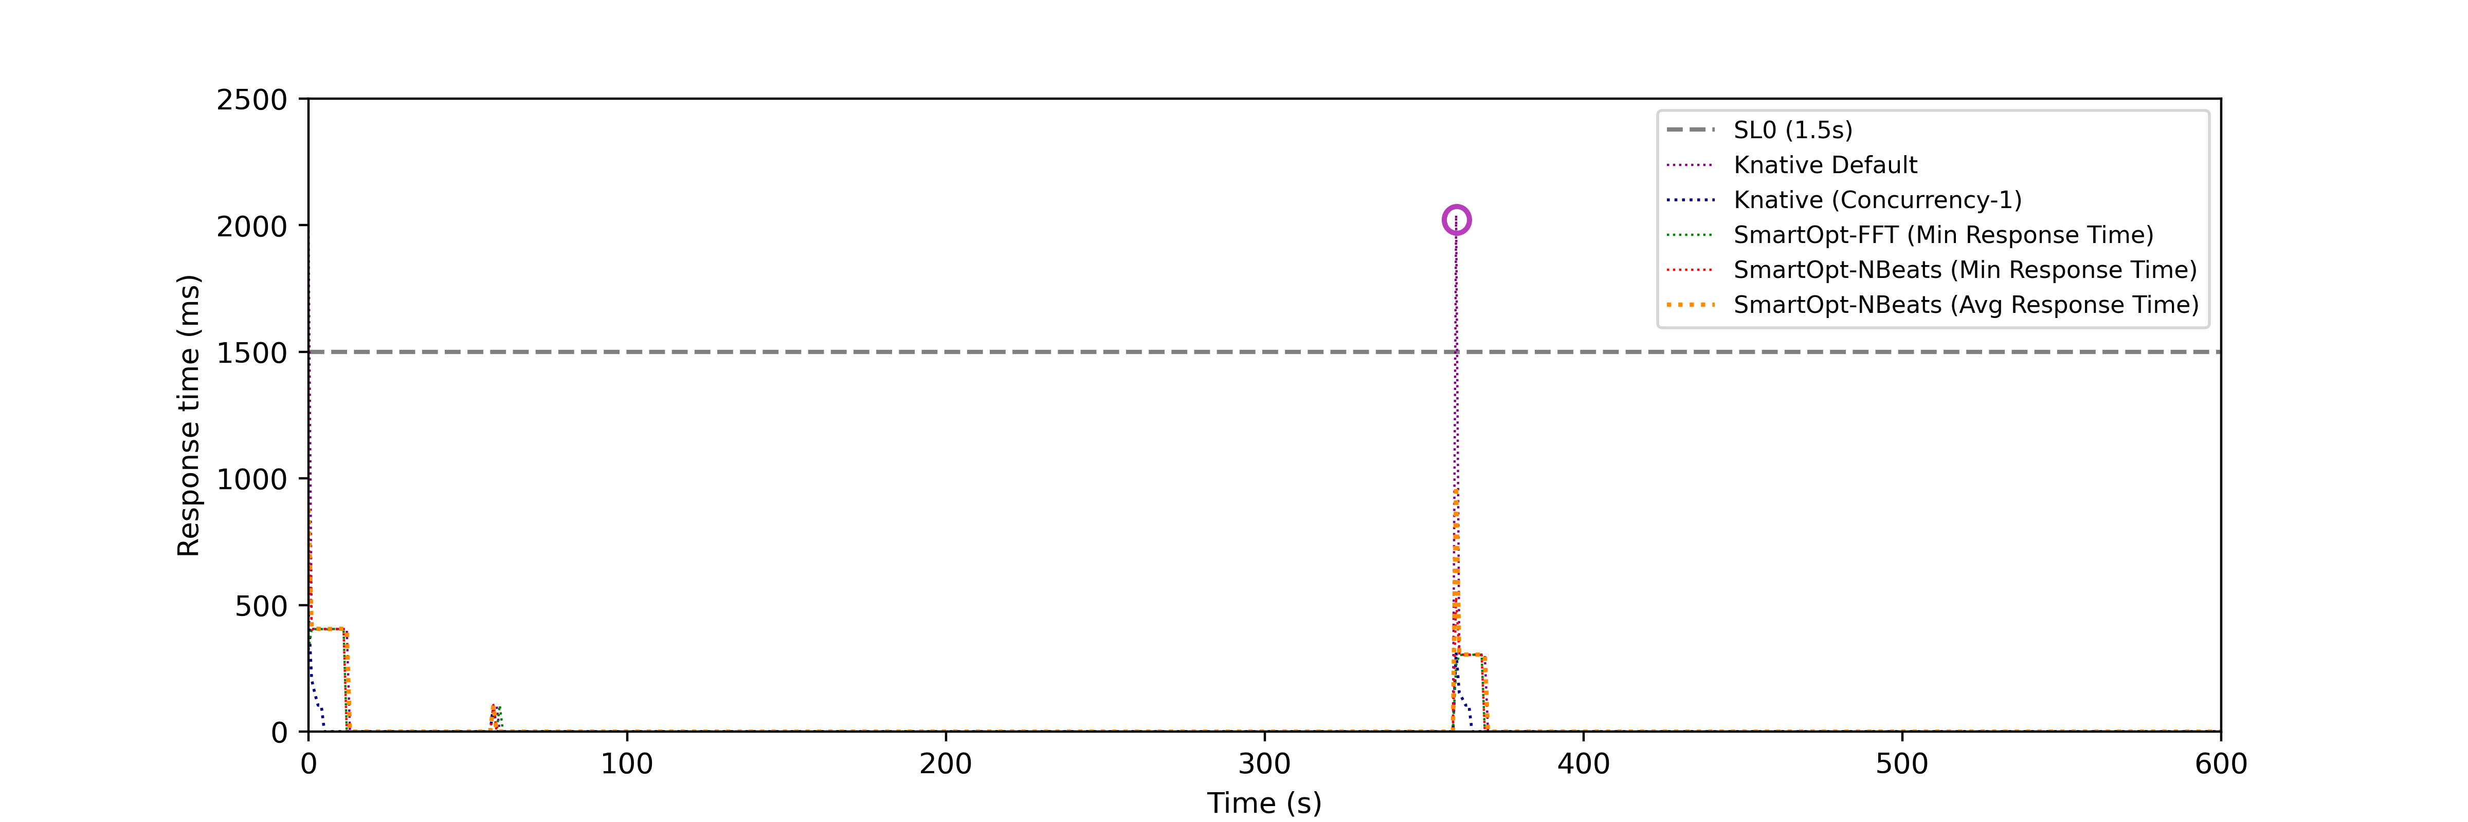
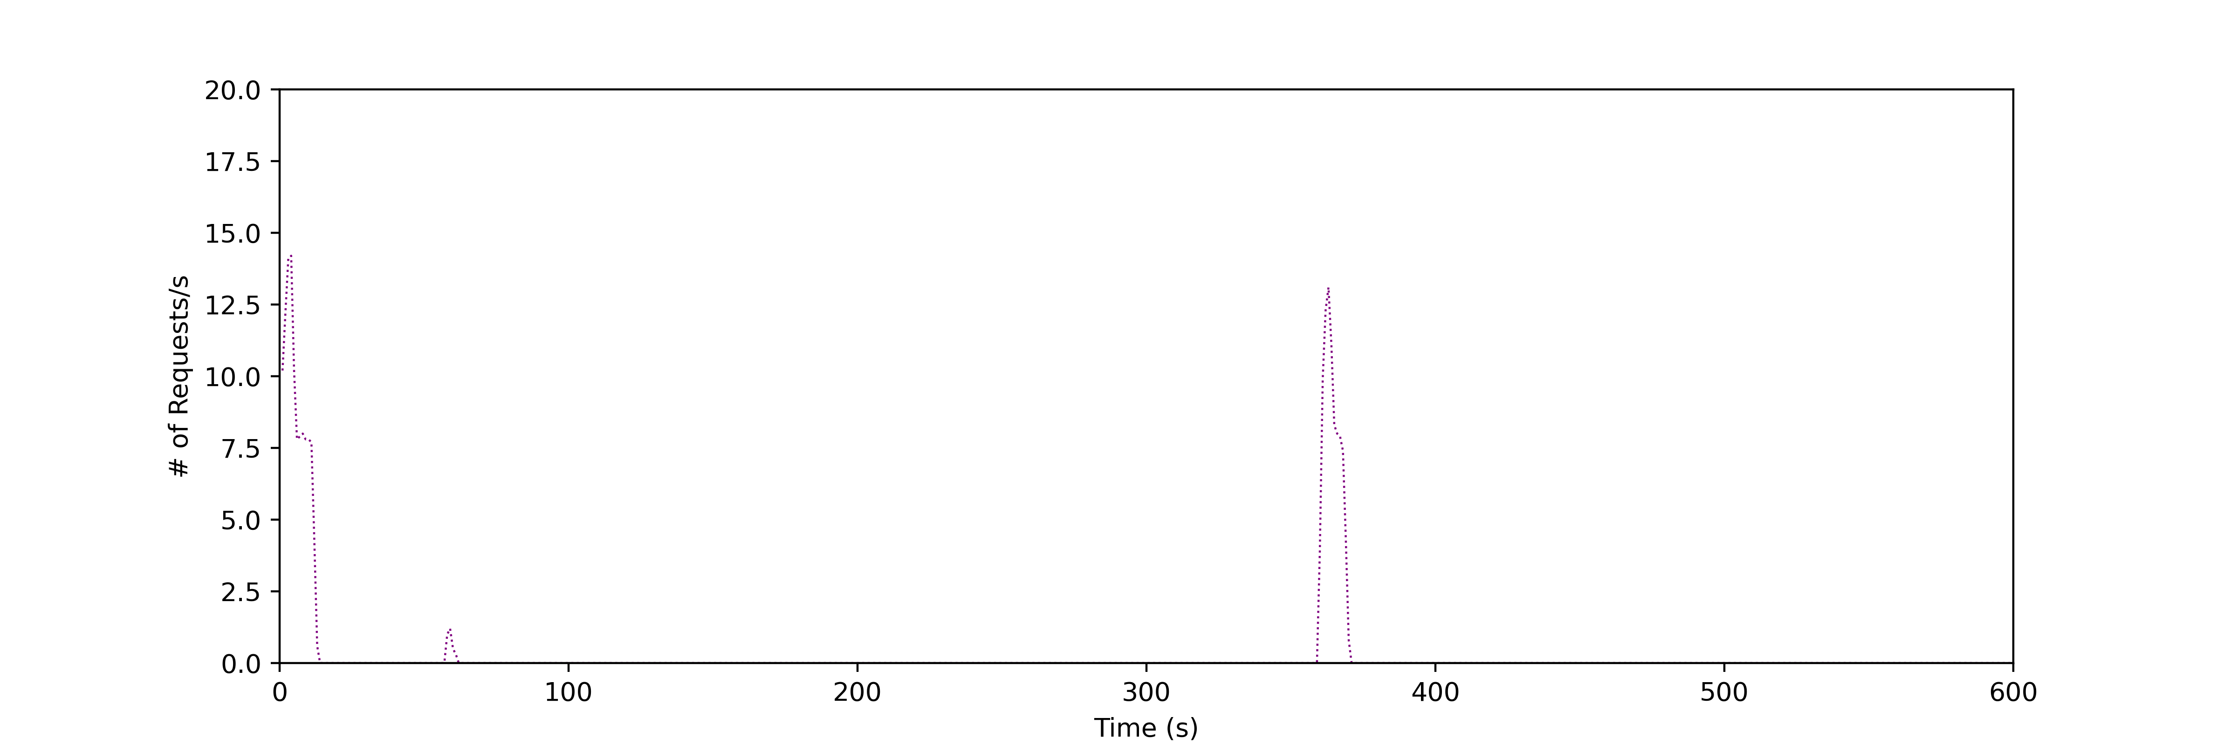
Response Time – Category 4
Fig 1: Response Time (J)
Fig 2: User Requests Pattern

Slide 42
Cold Starts
A new container is initialized which involves all the processes of setting up of container environment depending upon the function requirements.
Memory and Computing resources like vCPUs are allocated.
Function along with all its dependencies like libraries are loaded.
The function is then executed and returns the result as a response to the request
42
Notes:
Now moving towards the limitations there is a common challenge in every serverless platform that is a problem of cold start.
When we deploy our service in the serverless environment with scalability to zero. When ever the first request comes. A new container is spin up from scratch. This process takes time and is called as cold start. See the paper from cloud computing.

Slide 43
Outline
Function as a Service (FaaS)
Existing Approach
Our Contribution
Methodology
Experimental Setup
Results
Conclusion
Future Work

Slide 44
Outline
Function as a Service (FaaS)
Existing Approach
Our Contribution
Methodology
Experimental Setup
Results
Conclusion
Future Work

